Slide 1
Insight@ADP Visualizing ADP’s National Employment Report
July 7, 2016

Slide 2
Roadmap for today’s discussion
Current state and
background
1
Context
2
Email to gather
your input
Who we are targeting
and their needs
Feedback
Audience
Insight@ ADP
6
3
Testing
Data
Our plan to test
with users
Dimensions of data and
How it is organized
5
Design
4
Iterations and
current mockup

Slide 3
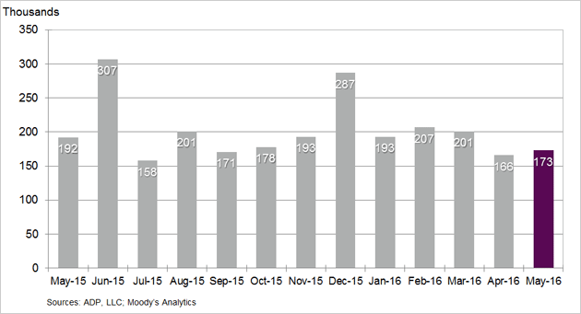
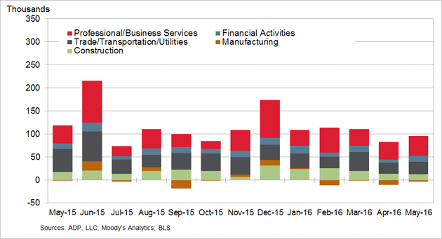
Current state and background
What is the National
Employment Report (NER)?
Current state of visualization
The National Employment Report (NER) is an estimate of total US employment produced monthly by ADP, a payroll service provider
1 in every 6 working Americans is paid via ADP (24 million workers)
The NER is watched closely by journalists and financial markets as an early indicator of economic health – it typically comes out a few days ahead of the official government employment report
Change in Nonfarm Private Employment
Change in Total Nonfarm Private Employment by Selected Industry
Our objective is to explore new and interactive ways for users to engage with the data and easily consume the economic insights that emerge from them

Slide 4
Business journalists and financial professionals are our target audience
Category | Stakeholder | Likelihood to visit | Need from Data | Visualization Need
Target Users | Business Journalists | High (need to deliver timely business insight to a general audience) | Want to report the most recent numbers Statistics to support a current story Background to inform a potential story | Communicative Make it simple to understand trends Give me a visual to support my story
 | Economists / Financial professionals | Medium / High (likely to get data from Bloomberg or aggregating data source) | Most recent data to inform economic models Investigate predictors to help forecast market movements | Exploratory Give me the raw data, so I can play with it myself Help me see trends to inform my own hypotheses
Potential future focus | Students | Medium (awareness of ADP report may be low) | Input to a exploratory model or a paper related to labor / economic concerns | Exploratory Make it easy for me to tailor data to my project
 | Policy makers | Medium (tend to favor official government data) | Context and supporting data for proposed legislation | Communicative Make it easy for me to see trends relative to my constituents
 | Small businesses | Low (busy running their businesses) | Put their own experience in context of the broader economy | Communicative Help me understand how I relate to businesses like me

Slide 5

User observation and interviews helped us to understand their needs better
Business Journalists
Economists and Financial Professionals
U.S. businesses added 173,000 jobs last month, lifted by strong gains in services……construction firms also hired more workers, while manufacturers shed jobs…
Global Macro Strategist
Using ADP to predict the BLS growth
Does it say something more broadly about GDP?
US Economist
The most important thing is how well ADP predicts BLS payrolls, and with what error
Interest Rate Strategist
How well ADP performed vs. consensus expectation
What does ADP imply for the BLS headline number?
-- Associated Press, June 2016
Florida added 17,100 private-sector jobs in May, a decrease of 10 percent from the 19,000 added in May 2015, according to a report Wednesday by payroll company ADP.
-- Sun Sentinel, June 2016

Slide 6
ADP’s National Employment Report has a number of dimensions that can be used for insight delivery

Slide 7
Based on current user research, we are planning to build two core visualizations
Bureau of Labor
Statistics (BLS) Comparison
Jobs Data Explorer
1
2
Allow users to explore the different dimensions of the National Employment Report via an intuitive and flexible visualization
Enable users to understand the predictive power of the National Employment Report by comparing it against historical Bureau of Labor Statistics data

Slide 8
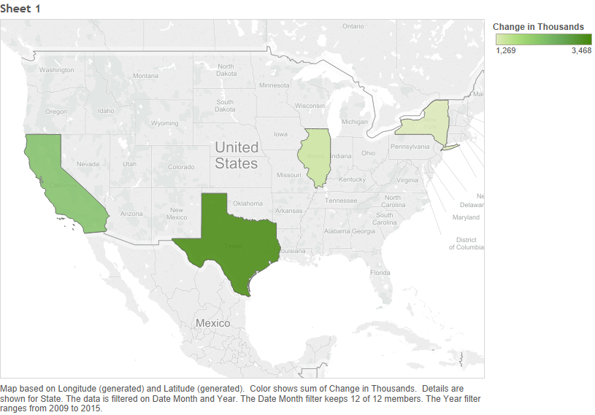
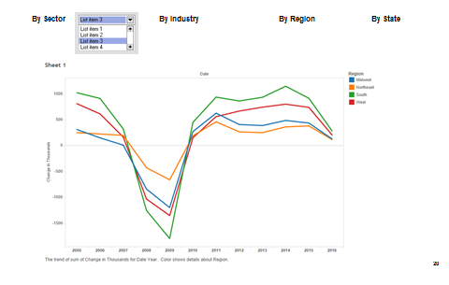
Initially, we tried a variety of approaches for jobs data explorer
Iteration 1
Iteration 2

Slide 9
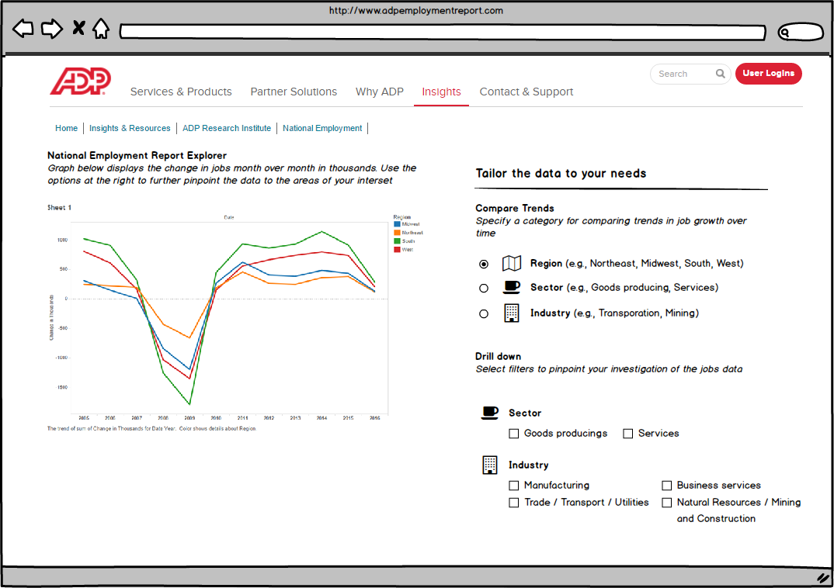
We built out the time series idea into a paper prototype…

Slide 10
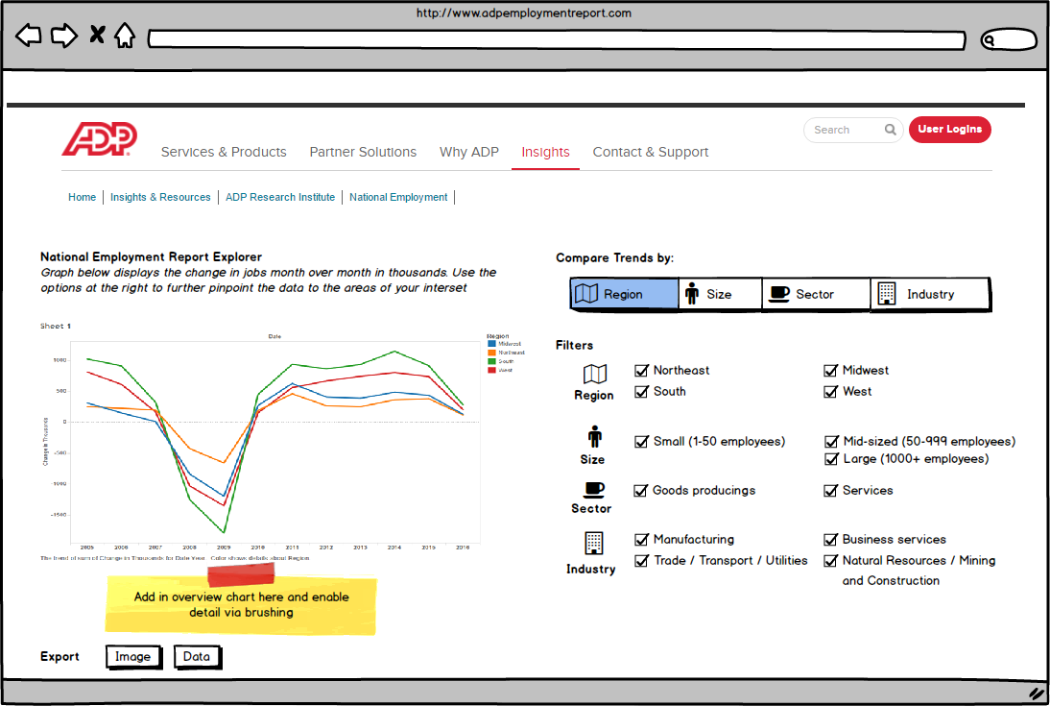
…and are continuing to refine via user input

Slide 11
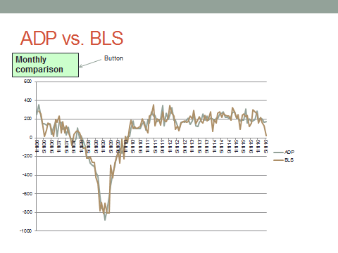
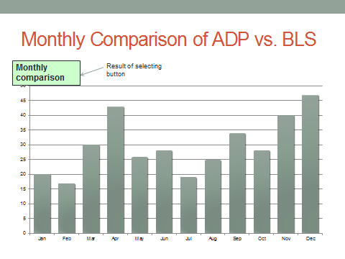
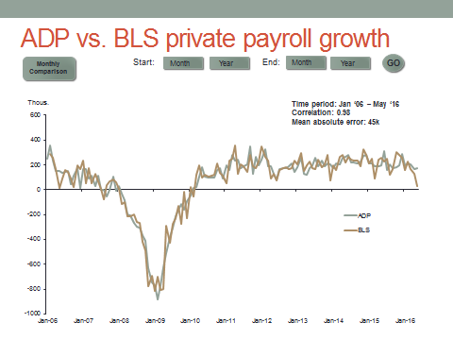
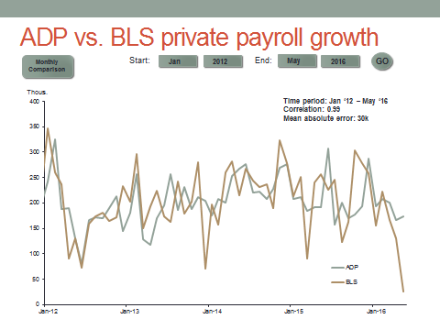
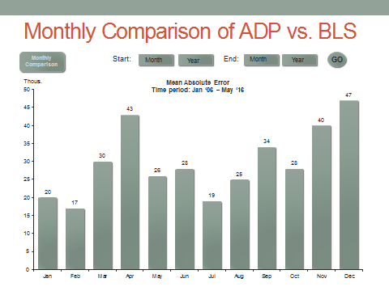
We chose to ADP vs. BLS comparison
Iteration 1
Iteration 2

Slide 12
ADP vs. BLS private payroll growth
Start:
End:
GO
Monthly Comparison
Month
Year
Month
Year
Thous.
Time period: Jan ‘06 – May ‘16
Correlation: 0.98
Mean absolute error: 45k
Notes:
Correlation over entire period, mean absolute difference between both over entire period.
Change and vary time periods, and do correlation and mean absolute difference.
Plot the error instead…(linked chart to below it that gives another cut)...Time series of the error (http://www.highcharts.com/demo/synchronized-charts)

Slide 13
ADP vs. BLS private payroll growth
Start:
End:
GO
Monthly Comparison
Jan
2012
May
2016
Time period: Jan ‘12 – May ‘16
Correlation: 0.99
Mean absolute error: 30k
Notes:
Correlation over entire period, mean absolute difference between both over entire period.
Change and vary time periods, and do correlation and mean absolute difference.

Slide 14
Monthly Comparison of ADP vs. BLS
Monthly Comparison
Start:
End:
Month
Year
Month
Year
GO
Notes:
Change time periods for this.

Slide 15
We plan to test our visualizations with our two target segments
Category |  | Timeframe |  | Description
User Discovery |  | 6/27 – 7/4 |  | Observe and interview target users (e.g., business journalists and finance professionals) Define data and visualization needs of target users including: How they approach / think about the data? What language they use to describe it? What comparisons / contextualization they are looking for?
Paper Prototyping |  | 7/4 – 7/18 |  | Test out emerging design concepts with users to gain feedback on design strategy and fit with users’ core needs 2 interviews per target user group
Usability Testing (via clickable prototype) |  | 7/25 – 8/4 (week 13) |  | Organize 3 usability sessions across user groups Develop a set of test tasks and questions for users to complete within an allotted time frame (~15 mins) Leverage insights to develop MoSCoW prioritization of issues

Slide 16
Please send us your comments and feedback
Saad Padela :: saad.padela@ischool.berkeley.edu

Slide 17
APPENDIX

